Slide 1
Catching Real-Time Insights with Amazon Kinesis
Suman Debnath
Principal Developer Advocate
Amazon Web Services

Slide 2

What is streaming data? Typical characteristics
High volume
Continuous
Ordered, incremental
Low-latency

Slide 3
Why streaming data? Get actionable insights quickly
Time critical decisions
Traditional “batch” business intelligence
Value of data to decision-making
Information half-life in decision-making
Preventive/Predictive
Actionable
Reactive
Historical
Real time
Seconds
Minutes
Hours
Days
Months
Source: Perishable insights, Mike Gualtieri, Forrester

Slide 4




Amazon Kinesis
Kinesis is a managed alternative to Apache Kafka
Great for application logs, metrics, IoT, clickstreams
Great for “real-time” big data
Great for streaming processing frameworks (Spark, NiFi, etc...)
Data is automatically replicated synchronously to 3 AZ
Amazon Kinesis
Data Streams
Amazon Kinesis
Data Firehose
Amazon Kinesis
Data Analytics
Amazon Kinesis
Video Streams
Notes:
• Kinesis Streams: low latency streaming ingest at scale • Kinesis Analytics: perform real-time analytics on streams using SQL • Kinesis Firehose: load streams into S3, Redshift, ElasticSearch & Splunk

Slide 5

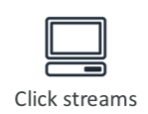




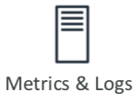

Amazon Kinesis
Amazon S3
Amazon Kinesis
Amazon Redshift
Amazon Kinesis
Data Streams
Amazon Kinesis
Data Firehose
Amazon Kinesis
Data Analytics
Amazon
Elasticsearch Service

Slide 6

Kinesis Streams Overview
Streams are divided in ordered Shards/Partitions
Data retention is 24 hours by default, can go up to 7 days
Ability to reprocess / replay data
Multiple applications can consume the same stream
Once data is inserted in Kinesis, it can’t be deleted (immutability)
Up to 1 MB or 1000 records per second, per shard
Producer
Shard 1
GetRecords()
Consumer
Shard 2
Up to 2MB per second, per shard
Shard n

Slide 7
Kinesis Streams Shards
One stream is made of many different shards
Billing is per shard provisioned, can have as many shards as you want
Batching available or per message calls.
The number of shards can evolve over time (reshard / merge)
Records are ordered per shard
Producer
Shard 1
Consumer
Shard 2
Shard n

Slide 8
Kinesis Streams Records
Data Blob –
Data being sent, serialized as bytes. Up to 1 MB. Can represent anything
Record Key –
Sent alongside a record, helps to group records in Shards. Same Key = Same Shard
Use a highly distributed key to avoid the “hot partition”
Sequence Number –
Unique identifier for each records put in shards. Added by Kinesis after ingestion
Data Blob
(up to 1MB)
Bytes
Record Key
Record Key

Slide 9
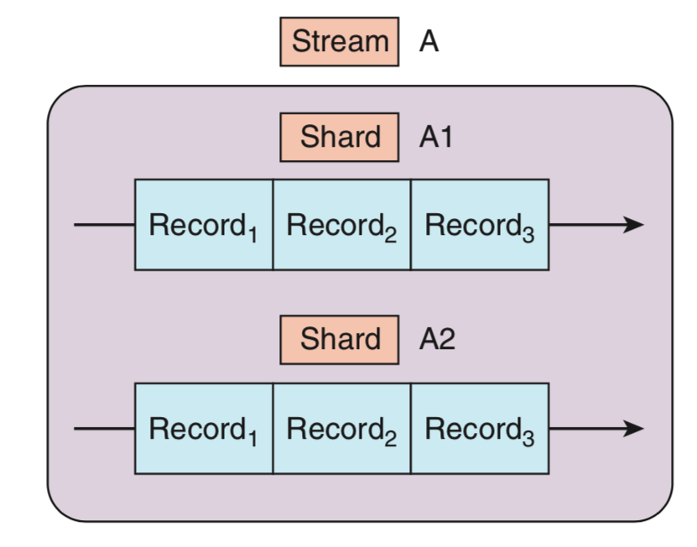

Kinesis Streams Records
Shard A
Shard B
Shard N

Slide 10







Kinesis Producers
AWS SDK
Amazon
Kinesis Data Stream
Kinesis Producer Library
Kinesis Agent

Slide 11

Kinesis Consumers
AWS Lambda
Amazon
Kinesis Data Stream
Amazon Kinesis
Data Firehose
Kinesis Producer Library
AWS SDK
Kinesis Agent

Slide 12
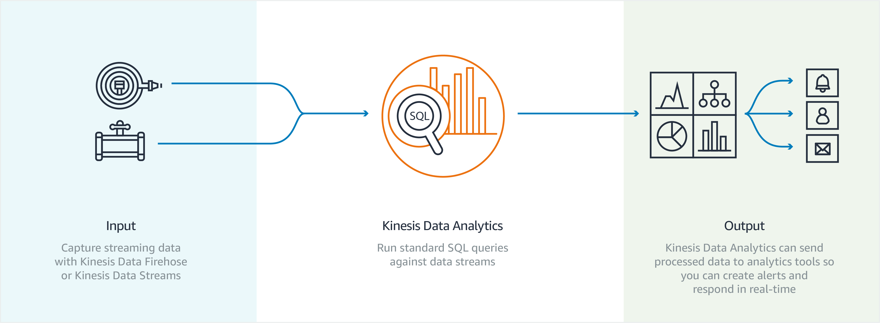
Kinesis Data Analytics

Slide 13
Demo
Subtitle

Slide 14
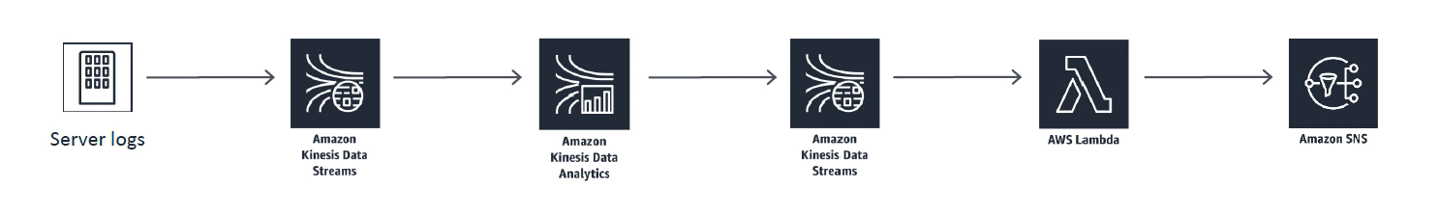
Transaction Rate Alarm

Slide 15
Thank you

Slide 16
Kinesis Firehose
Fully Managed Service, no administration
Near Real Time (60 seconds latency minimum for non full batches)
Load data into Redshift / Amazon S3 / ElasticSearch / Splunk
Automatic scaling
Supports many data formats
Data Conversions from JSON to Parquet / ORC (only for S3)
Data Transformation through AWS Lambda (ex: CSV => JSON)
Supports compression when target is Amazon S3 (GZIP, ZIP, and SNAPPY) • Only GZIP is the data is further loaded into Redshift
Pay for the amount of data going through Firehose
Spark / KCL do not read from Firehose
Notes:
• Fully Managed Service, no administration • Near Real Time (60 seconds latency minimum for non full batches) • Load data into Redshift / Amazon S3 / ElasticSearch / Splunk • Automatic scaling • Supports many data formats • Data Conversions from JSON to Parquet / ORC (only for S3) • Data Transformation through AWS Lambda (ex: CSV => JSON) • Supports compression when target is Amazon S3 (GZIP, ZIP, and SNAPPY) • Only GZIP is the data is further loaded into Redshift • Pay for the amount of data going through Firehose

Slide 17
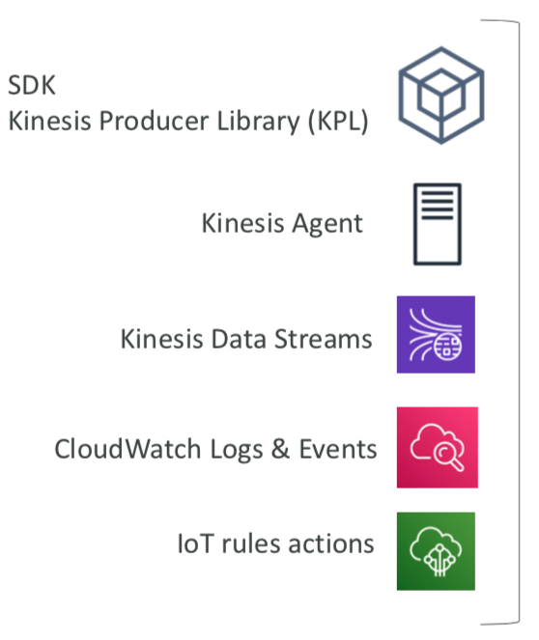
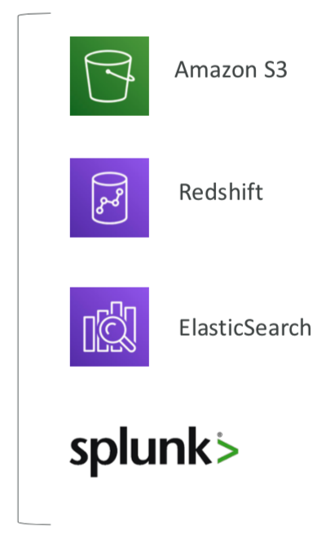
Kinesis Data Firehose
AWS Lambda
Amazon Kinesis
Data Firehose

Slide 18
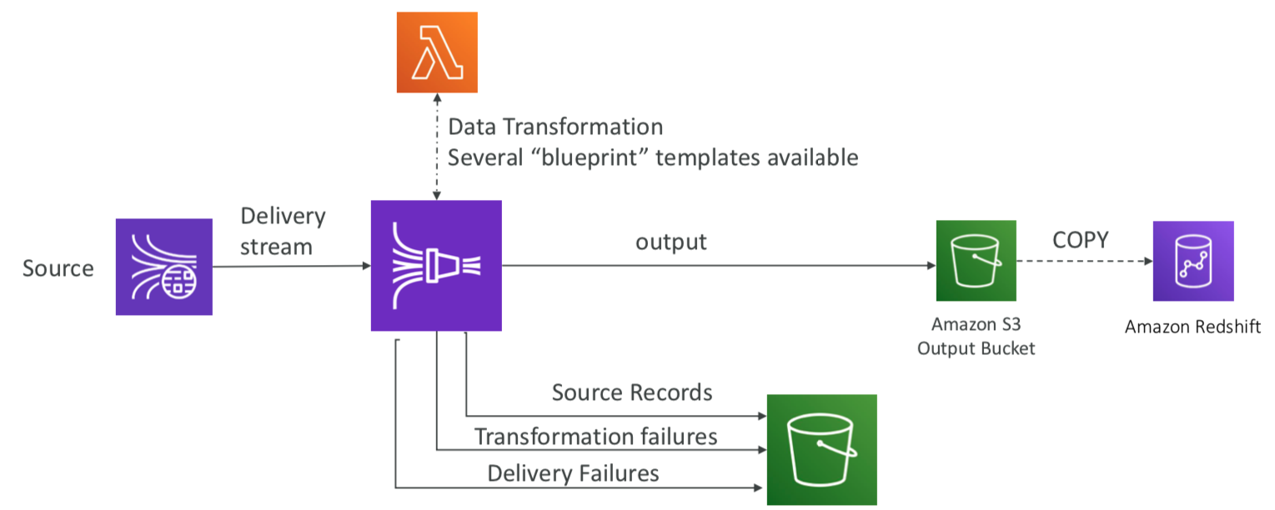
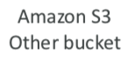
Kinesis Data Firehose Delivery Architecture

